Slide 1
CELLO CRE MODELING FRAMEWORK
July 2015

Slide 2
INVESTMENT APPROACH
RELATIVE-VALUE FOCUS
Cello believes that the same fundamental factors influence valuations in CRE across Fixed Income and Equities.
The investment process and proprietary infrastructure will be the same across the Portfolio.
The initial allocation is expected to be approximately 70% in Fixed Income and 30% in Equities.
A Relative Value Approach is Applied Across the Portfolio
CRE EQUITIES
REITs
Retail
Other CRE Names
CMBS & Mortgage Lending
CMBX
Cash CMBS
CRE Mezzanine Lending
CMBS MARKET
EQUITY MARKET
CRE INVESTMENT PROCESS
CORPORATE DEBT MARKET
Corporate CRE
Unsecured Debt
PropCo Debt
Corporate Loans
CDS
Notes:
The draft you sent over had this title. It doesn’t look correct?

Slide 3
CRE Modeling HOLDERS OF CRE RISK: A CAPITAL MARKETS VIEW
Products based on real estate have been developed for, and are traded in all four branches of the capital markets – Debt/Equity, Public/Private.
The asset and loan coverage of some of these markets is comprehensive enough to provide significant insight into macro-level trends.
Unique characteristics of individual properties and securities linked to these properties, different forms of economic interest in commercial real estate (direct/indirect, public/private) and the varying preferences of investors create significant market segmentation.
Cello’s framework for CRE analysis connects valuation information across the various capital markets that price CRE risk with the goal of identifying pricing inefficiencies that create relative value opportunities.
DEBT
EQUITY
Commercial Mortgage Backed Securities (CMBS)
CMBX
Corporate Loans
CDS
Equity REITs
Public Real Estate Property Companies
Real Estate Mutual Funds
Retail
PUBLIC
Senior Loans
Mezzanine Debt
Mortgage Whole Loans
Open and Closed End Funds
Separate Accounts/Direct Investments¹
Non-Traded REITs
PRIVATE
¹Direct investment in real estate involves purchasing a property outright and assuming operating control over rent policy and collection, maintenance, and growth.

Slide 4
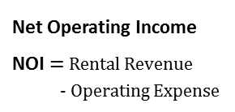
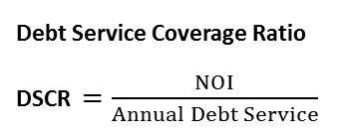
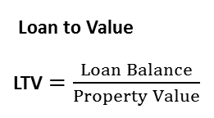
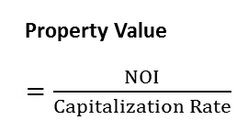
CRE Modeling COMMERCIAL PROPERTY AND Loan basics
As in the case of residential properties, most commercial properties are financed with mortgages.
The most important metrics of a property’s financial condition are its Net Operating Income (NOI), its Debt Service Coverage Ratio (DSCR), and its Loan-to-value Ratio (LTV).
The key credit events associated with a commercial mortgage include a Term Default, a Maturity Default and Extension Risk.
Extension Risk: Borrowers with a mortgage that is not in default at maturity but does not meet prevailing underwriting standards will attempt to extend the loan with the lender. Loans that are extended may ultimately default.
Capital Structure of a Sample Property
Life Cycle of a Sample Commercial Mortgage Loan
Credit events for Commercial mortgages
Term Default :
Borrower is unable to meet interest obligations and defaults on the mortgage before maturity
Maturity Default:
Borrower is unable to refinance or payoff the loan balance at maturity
Extension Risk:
Servicer/Lender has to extend loan maturity
Mortgage
Mortgage
LTV
= 80%
Total
Property
Value = 100%
Maturity Default Risk
Borrower
Equity
Term Default Risk
Extension Risk
Year 0
Year 10
Year 12
Original Loan Issuance
Stated Loan Maturity
Final Payoff
Key Term Definitions
Net Operating Income
NOI$=$ Rental Revenue
- Operating Expense
Property Value
a$=\frac{NOI}{Capitalization Rate}$
Loan to Value
LTV$=\frac{Loan Balance}{Property Value}$
Debt Service Coverage Ratio DSCR $=\frac{NOI}{Annual Debt Service}$
Source: Blackrock, Cello

Slide 5













CRE Modeling IDIOSYNCRATIC RISKS CAN PLAY A SIGNIFICANT ROLE IN CRE
The value of commercial real estate is affected by geographic, demographic, urban and local economic factors as well as the overall state of the economy.
Like other asset classes, the asset risk of a commercial property comes from both market uncertainty and from idiosyncratic sources.
More than other asset classes, idiosyncratic risk can play a very significant role because of the local nature of real estate.
Asset Risk: Market and Idiosyncratic Factors
$${NOI}_{Disp.,t}^{Up}$$
$${NOI}_{Mkt,t}^{Up}$$
$${NOI}_{Disp.,t}^{Flat}$$
$${NOI}_{Disp.,t}^{Down}$$
$${NOI}_{Disp.,t}^{Up}$$
$${NOI}_{Asset,t}^{}$$
$${NOI}_{Mkt,t}^{Flat}$$
$${NOI}_{Disp.,t}^{Flat}$$
$${NOI}_{Disp.,t}^{Down}$$
$${NOI}_{Disp.,t}^{Up}$$
$${NOI}_{Disp.,t}^{↑}$$
$${NOI}_{Mkt,t}^{Down}$$
$${NOI}_{Disp.,t}^{Flat}$$
$${NOI}_{Disp.,t}^{−}$$
$${NOI}_{Disp.,t}^{Down}$$
$${NOI}_{Disp.,t}^{↓}$$
Market Uncertainty
Individual
Dispersion

Slide 6
CRE Modeling CRE Modeling framework: ETUDE
The hub of Cello’s Investment Process is the CRE Asset and Loan Modeling Framework – Etude
The framework provides a systematic way to track and forecast property- and loan-level metrics at a micro- and macro-level.
The outputs of this framework provide a foundation for the detailed credit work needed to address idiosyncratic issues.
Etude Components
Property, Loan and Securities Database
Property-level data
Loan-level data
CMBS Deals
Property and Loan-Level Reviews
Property conditions: Financials & Physical Inspections (where appropriate)
Qualitative underwriting review for large, delinquent, or special serviced loans
Quantitative vetting for all other loans
Model Assumptions
NOI and Cap rate forecasts
Default triggers (e.g. DSCR levels)
Extension parameters
Workout Periods/Costs
Other model parameters
Loan Cash Flow and Outcome Projections
Cash flow and outcome estimates for each loan
Outcomes include: Payoff/Term Default/Maturity Default/Extension
Scenario analysis
Property and Loan Trends
Establishing Themes
Gain insight into property- and loan-level trends that can be applied to both public and private holders of real estate
The new issue commercial loan market provides substantial insight into prevailing cap rates

Slide 7
CRE Modeling DATA SOURCES FOR MODELING CRE RISK
There are a number of datasets available that cover different aspects of the CRE asset and loan markets.
Collectively, these datasets are used as the foundation for both model development and validation.
Empirical Data Sources
 | Data Level | Property Coverage | Geographic Coverage | Historical Coverage | Comments
Trepp CMBS Database | Loan | Financed through CMBS | US | 1998- | Comprehensive source for modeling loan outcomes
American Council of Life Insurers (ACLI) | Aggregate | Commercial Mortgages Originated/Held by Insurance Companies | US | 1965- | Longest History
Federal Deposit Insurance Corporation (FDIC) | Loan | Financed through commercial bank Loans and Leases | US | 1992- | Cover largest players
National Council of Real Estate Investment Fiduciaries (NCREIF) | Aggregate | Five Major Property Types | 50 Metropolitan Areas | 1978- | Widely Regarded
CB Richard Ellis Econometric Advisors (CBRE EA) | Aggregate | Market Rents and Vacancies | US | 1980-
Real Capital Analytics (RCA) | Loan | Property Value Over $5 Million | US | 2000-

Slide 8
CRE Modeling CRE model parameters and Assumptions
The CRE model forecasts the evolution of asset and loan metrics based on historical relationships, adjustments for idiosyncratic characteristics, and research insights.
The major model parameters include Income & Property Value Drivers and Loan Outcome & Loss Parameters.
For each parameter, several assumptions will be applied.
Assumption
Description
Income growth curves | MSA and property-type based projections of property-level NOI over time
Cap rates | Cap rate curves by property type Adjusted by property grades to account for individual property location and quality Combined with income projections to determine property value
Property grades | Individually assigned grades based on location, condition and size Used to adjust cap rates to account for individual property quality
DSCR default trigger | Monthly test that results in a term default if DSCR drops below a defined level Triggers are property type based
Loan extensions | Loans are extended at maturity if LTV falls within a defined band
Workout period | Time to resolution after a term or maturity default Jurisdiction-based (by State)
Liquidation costs | Percentage of property value at liquidation
Servicer reserves | Reserves held by the servicer are used to fund debt service payment shortfalls if income drops below the DSCR threshold
Property
Value Drivers
Loan Outcome Parameters

Slide 9
CRE Modeling SCENARIO ANALYSIS AND “WHAT-IF” QUESTIONS
Etude provides a framework for asking “what-if” questions and examining the effects on credit risks of any changes in model parameters/inputs.
Etude allows for the input of forward looking macroeconomic and market outlook scenarios that can be either direct user inputs or obtained from third-party forecasts (Federal Reserve, Moody’s Economy.com, PPR etc.)
Commercial Real Estate Price Index
Highest:
240
11.6%
239
-17.7%
-35.3%
Lowest: 136
Period Low:
150
* The shaded area corresponds to forecasts
Actual
2001 |  |  |  | 2008 |  |  |  | 2010 |  |  |  | 2014
Q1 | Q2 | Q3 | Q4 | Q1 | Q2 | Q3 | Q4 | Q1 | Q2 | Q3 | Q4 | Q1 | Q2 | Q3 | Q4
140 | 139 | 141 | 136 | 240 | 224 | 233 | 223 | 150 | 165 | 167 | 173 | 228 | 233 | 236 | 239
Projection
2015 |  |  |  | 2016 |  |  |  | 2017
Q1 | Q2 | Q3 | Q4 | Q1 | Q2 | Q3 | Q4 | Q1 | Q2 | Q3 | Q4
242 | 245 | 248 | 251 | 253 | 255 | 257 | 259 | 261 | 263 | 265 | 267
235 | 228 | 221 | 215 | 208 | 203 | 200 | 198 | 197 | 197 | 197 | 197
230 | 214 | 195 | 178 | 164 | 157 | 154 | 155 | 156 | 160 | 164 | 169
Baseline Scenario
Adverse Scenario
Severely Adverse Scenario
Source: Federal Reserve CCAR 2015 Supervisory Scenarios

Slide 10
CRE Modeling RESIDENTIAL LOANS VERSUS COMMERCIAL LOANS
There are some fundamental differences between modeling credit events for residential loans versus commercial loans.
The smaller population of commercial mortgages, heterogeneity of the underlying properties/loans, and the potential for large single loans to have an outsized impact on the returns of a securitization (“concentration risk”) all lead to a modeling process that combines qualitative and quantitative measures.
Collateral
Type
RESIDENTIAL LOANS
COMMERCIAL LOANS
Relatively homogeneous collateral - mortgages are secured by single family residences
More heterogeneous collateral - mortgages are secured by a variety of property types including office, retail, multifamily, industry and hospitality
Collateral
Size
Each RMBS securitization typically contains thousands of mortgages
Most CMBS securitizations contain approximately 15-300 mortgages
Generally the top 15 loans account for approximately 50% of the balance of a CMBS trust
Loan
Type
Primarily fixed-rate level-payment mortgages.
Usually a partially amortized balloon mortgage with 25 to 30 year amortization of principal and 5 to 10 year maturity.
Prepayment
Impact
Substantial because of the absence of prepayment penalties.
Lower impact because of stringent prepayment penalties including lock-outs, points, yield maintenance, and defeasance.
Default
Impact
The default of a single mortgage does not materially impact deal performance
The default of a single mortgage can have a significant impact on the owners of all related CMBS tranches
Documents
Greater consistency in loan documentation for residential mortgages
Loan documentation tends to be unique for each borrower/mortgage
Statistical
Modeling
Modeling is typically based on the law of large numbers, applying a probabilistic approach to projecting performance outcome (e.g. CDR, CPR, Severities, etc.)
Commercial real estate is less amenable to statistical modeling due to the idiosyncratic aspects of each underlying commercial property and mortgage
Source: Blackrock, Cello

Slide 11
CRE Modeling FORECASTING Loan outcomeS
Outcomes for CRE loans are triggered by the financial condition of the collateral.
The two standard triggers that play a significant role in determining loan outcomes are:
Whether the DSCR < 1.0
Whether the LTV > 100%
A credit or default event for a CRE loan is doubly triggered by: (1) The NOI falling below the total debt service and (2) The property market value falling below the total outstanding loan balance.
Potential Loan Outcomes
During initial term or extension | Term Default | DSCR < DSCR Default Trigger
At original maturity | Pay off | LTV < pay off LTV requirement
 | Extension | LTV between extension LTV bounds
 | Default | LTV > extension LTV limit
At extension maturity | Default | LTV > Refinance Threshold
Default, Extension and Payoff Logic Tree
Yes
Is DSCR < DSCR Default Trigger?
No
Loan is current, repeat process next month
Is loan at maturity?
No
Yes
Is loan LTV < pay-off LTV requirement?
Yes
Loan pays off
No
At extension maturity is
LTV < Refinance Threshold?
Is Loan LTV < extension LTV limit?
Yes
Maturity
Extension
Yes
Loan pays off
No
No
Term Default
Maturity Default
Maturity Default
All
Defaults
Loan Workout Period and Loss Calculation
Source: Blackrock, Cello
Notes:
The draft you sent over had this title. It doesn’t look correct?

Slide 12
CRE MODELING LARGE LOAN ANALYSIS
Largest Loan Analysis
The loan is currently 18% of the trust.
Collateral consists of 8 individual office buildings (2.6 million square feet) with an aggregate occupancy of 53% as of March 31, 2015 which form part of a 100 acre, master planned, mixed use corporate park located in Metro Washington D.C.
Loan was modified in 2013 with an A/B Structure under which the Sponsor is contributing equity.
Cello sees potential B Note returns creating upside on the example bond.
EXAMPLE BOND WITH CELLO CREDIT MODEL SCENARIO ANALYSIS
Source: CoStar/Trepp/Bloomberg and Cello as of March 31, 2015
Notes:
The draft you sent over had this title. It doesn’t look correct?

Slide 13
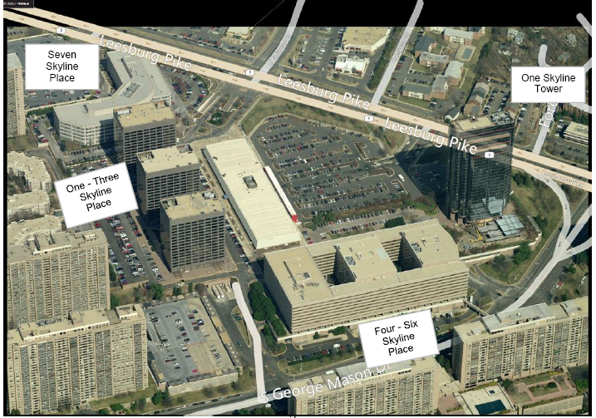
CRE MODELING PROPERTY INSPECTIONS
The Skyline Portfolio was a key transaction valuation component of the Bond example presented on page 17 and would be the subject of physical Cello due diligence prior to an investment.
Cello has a relationship with a Dallas-based Special Servicer; a partnership we use for portions of the Due Diligence process.
PHYSICAL DUE DILLIGENCE OF PROPERTY
Notes:
The draft you sent over had this title. It doesn’t look correct?

